Slide 1

Stock Market Investment Analysis
A Data Analytics Internship Project Presentation
by Thrive Africa Data Science and Analytics Interns
Group Nine

Slide 2
Table of Content
Introduction
Project Overview
Problem Statement
Data Overview
Description of The Dataset
Data Sources
Feature engineering tasks
Methodology(Data Cleaning & Processing )
Dashboard Overview
Key Insights
Visual Highlights
Summary of Insights
Recommendations
Conclusion
Q&A / Thank You

Slide 3
Group Two
Project Overview
Introduction
This report provides insights derived from the Stock Market dashboard. It summarizes trading performance, market volume trends, volatility, and day-by-day behavior to support data-driven investment and market analysis decisions.
High-quality financial data is often proprietary and costly to obtain, which limits open access for researchers, analysts, and students. This dataset provides a comprehensive historical record of U.S. stock and ETF performance, covering the NYSE, NASDAQ, and NYSE MKT exchanges. It contains daily price and volume data for thousands of U.S.-based securities, making it an excellent foundation for studying market trends, volatility patterns, and price forecasting.
Problem statements & analytic questions
Detect periods of high volatility and quantify risk over time.
Identify trends (uptrends / downtrends / sideways) and turning points.
Evaluate intraday performance vs. daily close (gaps, momentum).
Measure the relationship between price movement and trading volume.
Compute technical indicators to support trading/strategy signals.

Slide 4
Group Nine
Feature Engineering Tasks &Key Market Metrics
Data Overview
Metric | Value | Insight
Total Volume | 28T | Reflects overall liquidity and market activity — trading levels are high.
Max Value | 2bn | Indicates the highest single trade or instrument value recorded.
Distinct Count (Transactions) | 17M | Suggests high participation and broad trading engagement.
LDSS % (Low Daily Shares Sold %) | 1.6% | Represents the portion of sessions ending with a loss; volatility remains moderate.
HDSS % (High Daily Shares Sold %) | 1.7% | Reflects sessions with strong positive performance; nearly balanced with losses.
Total Open | 458.13bn | Shows the total outstanding positions currently open in the market.
Month-on-Month (MoM) Change | -58.0% | Indicates a sharp decline in monthly volume, possibly signaling cooling investor interest.

Slide 5
Group Nine
To ensure accuracy and reliability in the analysis, the following data cleaning and preprocessing steps were performed after Data Collection
Methodology
Handling Missing Values : Checked for missing values in key columns
Removing Duplicates : Checked for duplicate entries using Startup Name, Industry, Funding Round, and Investment Amount.
Standardizing Currency Formats : Ensured Investment Amount and Valuation were in consistent USD format (some datasets use different currency formats).
Formatting Date Columns : Converted Year Founded into a proper date format for trend analysis.
Data Extraction
Data Cleaning
Data Transformation
Clean Data
Handling Missing Values
Removing Duplicates &
Empty cells

Slide 6
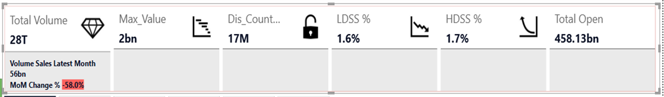
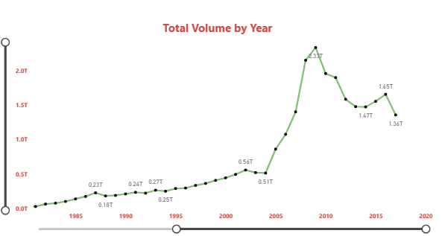
Group Nine
1️⃣ Overall Market Activity
Total Volume: 28T Total
Open: 458.13 bn
Max Value: 2 bn
These values show the scale of trading activity very high transaction volumes, which means the market is liquid and active.
📊 Insight:
The market is healthy in terms of liquidity, but the next panels show that performance (gains/losses) fluctuates significantly across years.
6️⃣ Key KPI Panel at the Top
LDSS % = 1.6 %
HDSS % = 1.7 %
MoM Change % = −58.0 %
Volume sales for the latest month dropped 58 % compared to the previous month.
📊 Insight:
Recent market activity shows a sharp decline in trading momentum, suggesting a slowdown in investor sentiment or lower market volatility.
Dashboard Overview
2️⃣ Volume Trends (Line Chart: “Total Volume by Year”)
The chart shows a steady increase in trading volume from the 1980s to around 2010, where it peaks at about 2T.
After that, volumes decline slightly but remain high, suggesting a cooling off or stabilization phase.
📊 Insight:
Market participation grew dramatically until 2010 — possibly due to digital trading or economic growth — then normalized in the following decade.

Slide 7
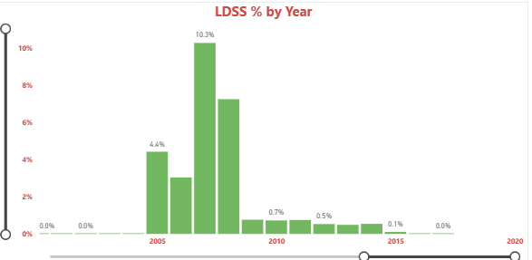
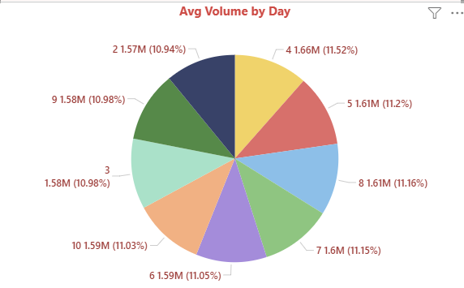
Group Nine
3️⃣ LDSS % by Year (Low Daily Share Sales % Trend)
The percentages (LDSS %) spiked sharply around 2005 – 2010, peaking at 10.3 %, before falling back below 1 %.
📊 Insight:
There was a high-volatility or crisis period (perhaps related to an economic downturn or market correction) around 2005 – 2010, followed by a more stable era.
Dashboard Overview
4️⃣ Average Volume by Day (Pie Chart)
The daily average volumes are balanced, each day contributing roughly 10 – 11 % of total trades.
📊 Insight:
Trading activity is well-distributed across weekdays no major bias toward specific days, indicating consistent market engagement.

Slide 8
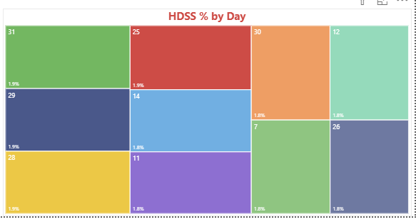
Group Nine
5️⃣ HDSS % and LDSS % by Day (Tree maps)
Each block (day) represents percentage of high or low day stock sessions. The color and size show which days experience more highs (HDSS %) or lows (LDSS %).Days like 25, 30, 31 seem more active in losses or highs, while mid-month days are steadier.
📊 Insight:
End-of-month days show greater volatility, possibly due to portfolio rebalancing or reporting effects. Early-month days are relatively calm.
NB: Tree map breaks data into rectangular blocks —each block’s size represents a numeric value and each block’s label (like 31, 25, 30, etc.) represents the Day of the month.
Larger rectangles = higher loss percentage (Higer losses).Smaller rectangles = lower loss percentage (Lower).
Dashboard Overview

Slide 9
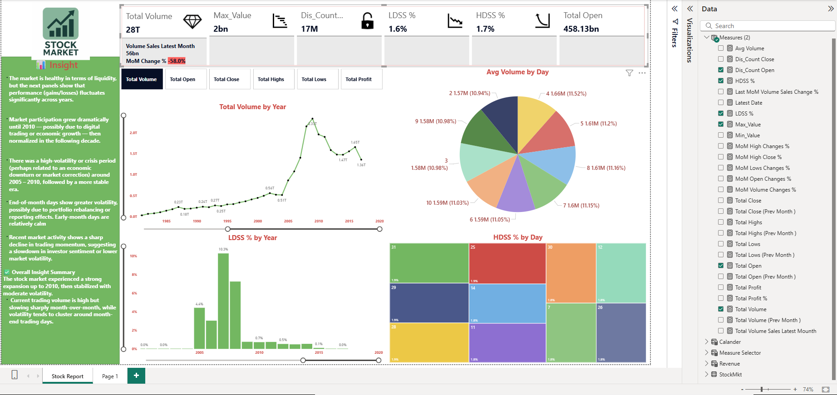
Group Nine
Dashboard Overview

Slide 10
Daily Patterns
Volume and Volatility Trends
Group Nine
Average Daily Volume: Spread evenly across the week each day contributes about 10–11% of total trading activity.
Volume Growth: The total trading volume shows a steady rise from the 1980s, reaching a peak around 2010.
Post-2010: Volumes remain strong but more stable a sign of market maturity and less speculation.
Summary of Insights
Daily Patterns
Summary of Insights
Category | Observation | Implication
Liquidity | 28T total volume | Highly active market, strong investor presence.
Volatility | LDSS 1.6%, HDSS 1.7% | Balanced gain–loss distribution → stable market environment.
Momentum | -58% MoM change | Recent slowdown in trading; possible seasonal or sentiment-driven.
Long-term trend | Volume peaked 2010 | Suggests digitalization and market maturity after expansion.
Day pattern | End-month volatility | Indicates cyclical trading pressures.
Market liquidity remains high with 28T in total volume.
✅ Volatility is moderate and balanced between gain and loss sessions.
✅ The market shows signs of stabilization post-2010, after an intense growth and correction phase.
✅ Month-on-month activity dropped sharply (-58%), signaling short-term investor caution.
✅ End-of-month days exhibit the highest volatility, consistent with institutional trading patterns.

Slide 11
Recommendations
Conclusion
Group Nine
Monitor End-of-Month Trading Behavior
Identify repeating volatility patterns for better timing of trades.
Enhance Predictive ModelsApply moving averages, RSI, and Bollinger Bands to assess long-term momentum.
Track Investor Sentiment
Use MoM volume trends and loss frequency to gauge investor confidence.
Diversify During High-Volatility Periods
Encourage balanced portfolios to minimize exposure during unstable cycles.
The Stock Market dashboard reveals a mature yet dynamic market with strong liquidity, moderate volatility, and cyclical trading behavior. While the short-term decline in volume suggests cautious sentiment, long-term stability remains evident. Continuous monitoring of end-of-month patterns and volume shifts will help maintain strategic market insights.
Summary of Insights
Thank you
Q & A

